Slide 1
City of Joliet
2016 Proposed Budget
November 30, 2015

Slide 2
CITY OF JOLIET
2016 BUDGET
REVENUES AND EXPENDITURES
INCLUDING TRANSFERS-IN AND TRANSFERS-OUT
OVERVIEW - ALL FUNDS
 |  | PRIOR | PRIOR | CURRENT | ACTUAL | ESTIMATED | DEPARTMENT | CITY | CITY
FUND |  | YEAR | YEAR | BUDGET | AS OF | YEAR | REQUEST | MANAGERS | COUNCIL
NO. | FUND | ACTUAL | ACTUAL |  | 6/30/2015 | END |  | RECOMMENDED | APPROVED
 |  | 2013 | 2014 | 2015 |  | 2015 | 2016 | 2016 | 2016
 | REVENUES
100 | General Fund | 167,518,830 | 167,340,949 | 163,918,725 | 80,916,768 | 166,273,273 | 167,845,489 | 168,950,989 | 0
500 | Water & Sewer | 45,207,211 | 43,438,866 | 41,750,600 | 21,919,631 | 43,488,508 | 41,510,000 | 41,510,000 | 0
501 | Water & Sewer Improvement Fund | 0 | 0 | 0 | 0 | 0 | 0 | 0 | 0
520 | Parking Operations Fund | 1,434,113 | 1,302,505 | 1,323,500 | 628,733 | 1,257,466 | 1,257,466 | 1,257,466 | 0
200 | Motor Fuel Tax Fund | 4,694,772 | 5,201,704 | 3,710,000 | 1,787,181 | 3,841,706 | 3,710,000 | 3,710,000 | 0
220 | Grants & Special Accounts Fund | 12,671,363 | 8,055,851 | 10,004,000 | 1,950,993 | 6,553,264 | 26,459,801 | 26,459,801 | 0
110 | Evergreen Terrace Fund | 0 | 0 | 0 | 61,728 | 61,728 | 0 | 0 | 0
210 | Community Development Block Grant | 20,729 | 9,389 | 1,315,818 | 645 | 62,880 | 3,850,000 | 3,850,000 | 0
230 | Special Services Area Fund | 428,521 | 485,955 | 461,390 | 193,501 | 432,436 | 432,436 | 432,436 | 0
250 | Tax Increment Financing Fund #2 | 547,767 | 605,407 | 600,100 | 405,603 | 406,060 | 600,100 | 600,100 | 0
251 | Tax Increment Financing Fund #3 | 18,677 | 63,823 | 63,400 | 36,831 | 36,831 | 63,400 | 63,400 | 0
240 | Business District Fund | 0 | 0 | 0 | 43,332 | 53,005 | 53,010 | 53,010 | 0
405 | General Debt Services Fund | 1,160,013 | 1,155,661 | 1,165,256 | 695,070 | 1,731,871 | 1,652,550 | 1,652,550 | 0
301 | Neighborhood Improvement Fund | 0 | 0 | 0 | 0 | 0 | 0 | 0 | 0
320 | Performance Bond Fund | 1,200,676 | 32,554 | 1,000,000 | 100,321 | 100,500 | 1,000,000 | 1,000,000 | 0
300 | General Capital Improvement Fund | 2,030,694 | 2,058,110 | 2,551,000 | 355 | 2,649,675 | 4,000,500 | 4,000,500 | 0
 | TOTAL REVENUE | 236,933,366 | 229,750,774 | 227,863,789 | 108,740,692 | 226,949,203 | 252,434,752 | 253,540,252 | 0
 | EXPENDITURES
100 | General Fund | 159,184,810 | 163,814,224 | 172,596,048 | 82,625,010 | 170,910,745 | 179,644,137 | 174,235,042 | 0
500 | Water & Sewer | 43,034,084 | 42,838,711 | 41,513,247 | 12,090,476 | 38,983,330 | 40,908,218 | 40,497,312 | 0
501 | Water & Sewer Improvement Fund | 15,183,706 | 8,519,202 | 28,098,650 | 5,932,058 | 15,815,509 | 28,738,095 | 19,550,000 | 0
520 | Parking Operations Fund | 1,504,328 | 1,560,123 | 1,680,320 | 545,861 | 1,514,426 | 1,708,322 | 1,586,160 | 0
200 | Motor Fuel Tax Fund | 4,254,880 | 3,034,291 | 14,677,559 | 843,182 | 7,235,218 | 11,141,981 | 11,141,981 | 0
220 | Grants & Special Accounts Fund | 11,684,275 | 12,200,103 | 10,000,000 | 2,902,210 | 5,804,420 | 26,459,801 | 26,459,801 | 0
110 | Evergreen Terrace Fund | 1,982,508 | 401,681 | 700,000 | 386,412 | 15,693,413 | 700,000 | 700,000 | 0
210 | Community Development Block Grant | 18,971 | 11,008 | 2,097,384 | 31,964 | 62,880 | 3,850,000 | 3,850,000 | 0
230 | Special Services Area Fund | 443,945 | 359,089 | 459,850 | 280,713 | 545,533 | 432,436 | 432,436 | 0
250 | Tax Increment Financing Fund #2 | 407,977 | 672,624 | 600,000 | 368,502 | 436,000 | 600,000 | 600,000 | 0
251 | Tax Increment Financing Fund #3 | 10,424 | 53,333 | 63,400 | 0 | 36,831 | 63,400 | 63,400 | 0
240 | Business District Fund | 0 | 0 | 0 | 2,942 | 53,005 | 53,010 | 53,010 | 0
405 | General Debt Services Fund | 1,159,856 | 1,163,256 | 1,165,256 | 152,853 | 1,723,517 | 1,652,550 | 1,652,550 | 0
301 | Neighborhood Improvement Fund | 585,220 | 49,501 | 0 | 0 | 199,175 | 0 | 0 | 0
320 | Performance Bond Fund | 1,701,590 | 655,766 | 5,000,000 | 0 | 1,000,000 | 4,000,000 | 4,000,000 | 0
300 | General Capital Improvement Fund | 4,014,840 | 3,074,304 | 6,570,996 | 1,923,789 | 4,675,895 | 45,165,134 | 3,966,000 | 0
 | TOTAL EXPENDITURES | 245,171,414 | 238,407,216 | 285,222,710 | 108,085,972 | 264,689,897 | 345,117,084 | 288,787,692 | 0

Slide 3
CITY OF JOLIET
2016 BUDGET
ENDING UNASSIGNED FUND BALANCE AND NET POSITION AS OF DECEMBER 31
OVERVIEW - ALL FUNDS
 |  | PRIOR | PRIOR | CURRENT | ACTUAL | ESTIMATED | DEPARTMENT | CITY | CITY
FUND |  | YEAR | YEAR | BUDGET | AS OF | YEAR | REQUEST | MANAGERS | COUNCIL
NO. | FUND | ACTUAL | ACTUAL |  | 6/30/2015 | END |  | RECOMMENDED | APPROVED
 |  | 2013 | 2014 | 2015 |  | 2015 | 2016 | 2016 | 2016
 | UNASSIGNED FUND BALANCE
100 | General Fund | 47,757,166 | 43,911,182 | 35,705,713 | 50,880,263 | 29,935,159 | 17,436,511 | 23,951,106 | 0
200 | Motor Fuel Tax Fund | 11,477,559 | 13,644,972 | 2,734,537 | 14,588,971 | 10,251,460 | 2,819,479 | 2,819,479 | 0
220 | Grants & Special Accounts Fund | 5,230,925 | 1,086,673 | 1,090,673 | 135,456 | 1,835,517 | 1,835,517 | 1,835,517
110 | Evergreen Terrace Fund | (1,982,508) | (2,384,189) | (3,084,189) | (2,708,873) | (18,015,874) | (18,715,874) | (18,715,874) | 0
210 | Community Development Block Grant | 12,844 | 11,500 | 4,639,154 | (19,819) | 11,500 | 11,500 | 11,500 | 0
230 | Special Services Area Fund | 125,805 | 252,671 | 99,795 | 165,459 | 139,574 | 139,574 | 139,574 | 0
205 | Tax Increment Financing Fund #2 | 623,116 | 555,899 | 555,999 | 593,000 | 525,959 | 526,059 | 526,059 | 0
206 | Tax Increment Financing Fund #3 | 16,991 | 27,481 | 26,391 | 64,312 | 27,481 | 27,481 | 27,481 | 0
240 | Business District Fund | 0 | 0 | 0 | 40,390 | 0 | 0 | 0 | 0
405 | General Debt Services Fund | 157 | (7,438) | 257 | 534,779 | 916 | 916 | 916 | 0
300 | Neighborhood Improvement Fund | 248,676 | 199,175 | 199,175 | 199,175 | 0 | 0 | 0 | 0
320 | Performance Bond Fund | 4,825,358 | 4,202,146 | 825,358 | 4,302,467 | 3,302,646 | 302,646 | 302,646 | 0
320 | General Capital Improvement Fund | 5,570,357 | 4,554,163 | 534,167 | 2,630,729 | 2,527,943 | (38,636,691) | 2,562,443 | 0
 | TOTAL UNASSIGNED FUND BALANCE | 73,906,446 | 66,054,235 | 43,327,030 | 71,406,309 | 30,542,281 | (34,252,882) | 13,460,847 | 0
 | NET POSITION
500 | Water & Sewer | 258,572,943 | 259,173,098 | 269,088,668 | 269,002,253 | 263,678,276 | 264,280,058 | 264,690,964 | 0
520 | Parking Operations Fund | 5,152,917 | 4,895,299 | 4,498,036 | 4,978,171 | 4,638,339 | 4,187,483 | 4,309,645 | 0
 | TOTAL NET POSITION | 263,725,860 | 264,068,397 | 273,586,704 | 273,980,424 | 268,316,615 | 268,467,541 | 269,000,609 | 0

Slide 4
2016 Summary – Operating Funds
General Fund
  Revenues - $168.9 million
  Expenditures - $174.2 million
  Use of Fund Balance = $5.3 million
Water & Sewer Fund
  Revenues - $41.5 million
  Expenditures - $40.9 million
  Increase In Net Position = $1.0 million
  $19.6 million in Capital Expenditures
Parking Fund
  Revenues - $1.28 million
  Expenditures - $1.59 million
  Use of Fund Balance = $328,694
  No upgrades budgeted. Operate system “as is”.
Notes:
The recommended annual budget for 2013 totals $274.3 million.
Including $194.5 million of operating funds
$29.8 million in capital funds
And $50.0 million in special funds

Slide 5
Operating Funds
2016 Proposed Budget

Slide 6
Operating Funds - Activities
General Fund
Supports general activities including: police and fire protection, planning and economic development, engineering services, code enforcement, garbage collection services, legal services, financial services, and general administration
Water & Sewer Fund
Provides for operations of water and sewer system including: 3 wastewater treatment plants, 450 miles of sanitary sewer, 26 wells, 11 water treatment plants, and 38 lift stations
Parking Fund
Supports operations of 2 parking decks, 7 parking lots, 700 on-street meters, and Joliet Union Station
Notes:
As a reminder the Operating Budget is the portion of the annual budget that supports the daily operations and services of the City.
The funding is divided between three primary funds:
The General Fund which supports the general activities.
The Water & Sewer Fund which provides for the city’s utility system
And the parking fund whose resources provide for the city’s parking operations.

Slide 7
Operating Budget - Summary
 | 2015 Budget | 2016 Proposed | $ Change | % Change
General Fund | $172.6 | $174.2 | $1.6 | 0.95%
Water & Sewer Fund | $41.5 | $40.5 | ($1.0) | (2.45%)
Parking Fund | $1.68 | $1.59 | ($.09) | (5.6%)
Total | $215.78 | $216.29 | $.51 | .23%
$ shown in millions

Slide 8
General Fund
2016 Proposed Budget

Slide 9
Operating Budget - Highlights
General Fund
$168.9 million in estimated revenues, an increase of $5.03 million over the 2015 Budget.
Includes a 4.99% increase in property tax levy ($1.625 million), a 3.5% increase in garbage fees($494,000) and an increase in real estate transfer tax from $3.00 to $5.00 per $1000 value ($1.1 million).
Includes funding for a Deputy City Manager/Economic Development Director ($145,000 in salary), upgrading a part time Office Assistant at the front desk to a full time Information Services Coordinator ($20,000), and $30,000 in equipment for channel 6
Includes required increases to public safety pension contributions
  Police Pension = $572,466; Fire Pension = $224,835
Allocates funding for removing blight on private property ($21,000), a TIF Study at St. Joe’s Hospital ($35,000),Maintenance of the City’s public art ($10,000), continued support of Rialto Theater and the Historical Museum at 2015 levels, first phase of improving the City’s GIS ($115,000) and contracting for electrical inspectors($62,400).
Accommodates $460k increase for waste management fees
Notes:
Highlights from the General Fund include:
A balanced budget with an estimated $158.3 million in revenues;
A continuation of the policy started in 2012 of a 60 day operating reserve;
Nearly $500k for the hiring of 10 additional police officers;
Fully funding salary costs to keep service levels consistent with 2012
Full funding for the Annual required contribution (ARC) to the public safety pensions $1.7 million;
Accommodation of a 2.9% increase in health insurance costs; and
A reduction in Overtime costs of over 11% due to the hiring of police officers and 8 firefighters
It should be noted that the General Fund budget does not contain the salary costs of the 8 new firefighters; these costs are part of the Special Funds budget because they are funded through a Federal Grant.

Slide 10
Operating Budget - Highlights
General Fund
Includes reduction of Fire Department overtime ($1,748,650) by closing a fire station
Includes realignment of the legal department budget to include an Inspector General ($124,357 savings)
Allocates continued funding for the new ERP system (Tyler/Munis)
Over $45 million requested in Capital Projects. The only projects that are recommended ($3.9 million) are those we are already committed to that includes: $400,000 for a Fiber Optic connection between Union Station and the Police Department, $150,000 to repair roof at Union Station, $166,000 to repair roof at Fleet Services and $750,000 for a Fiber Optic connection on Chicago Street.
No vehicles are part of the recommendation.
Notes:
Highlights from the General Fund include:
A balanced budget with an estimated $158.3 million in revenues;
A continuation of the policy started in 2012 of a 60 day operating reserve;
Nearly $500k for the hiring of 10 additional police officers;
Fully funding salary costs to keep service levels consistent with 2012
Full funding for the Annual required contribution (ARC) to the public safety pensions $1.7 million;
Accommodation of a 2.9% increase in health insurance costs; and
A reduction in Overtime costs of over 11% due to the hiring of police officers and 8 firefighters
It should be noted that the General Fund budget does not contain the salary costs of the 8 new firefighters; these costs are part of the Special Funds budget because they are funded through a Federal Grant.

Slide 11
General Fund – Revenues = $168.9 M

Slide 12
General Fund - Revenue Summary
 | 2013 Actual | 2014 Actual | 2015 Budget | 2015 Est. YearEnd | 2016 Proposed
Sales Tax | $ 43.4 | $ 44.8 | $ 44.0 | $ 45.7 | $ 45.7
Property Taxes | 33.1 | 33.1 | 32.9 | 32.5 | 34.1
Charges for Service | 24.1 | 23.1 | 23.2 | 23.0 | 23.5
Gaming Taxes | 19.7 | 19.2 | 19.3 | 18.9 | 18.9
Other Taxes | 20.5 | 22.3 | 21.4 | 20.9 | 22.0
Income Taxes | 16.2 | 13.9 | 14.1 | 14.9 | 14.9
License, Permits, Fees, Misc. | 10.3 | 10.9 | 9.0 | 10.4 | 9.8
Total | $ 167.5 | $ 167.3 | $ 163.9 | $ 166.3 | $ 168.9
$ shown in millions
Notes:
The $194.5 million allocated to support the operations of the City:
Includes $158.3 million for general operations a 3.6 percent increase from the 2012 Budget
$34.8 million to operate the water and sewer utility system or a 1.9 percent, and
$1.4 million to fund the City’s parking operations.

Slide 13
General Fund – Expenditures = $174.2 M
$ shown in millions

Slide 14
General Fund – Expenditures = $174.2 M

Slide 15
General Fund – Expenditure Summary
 | 2013 Actual | 2014 Actual | 2015 Budget | 2015 Est. YearEnd | 2016 Proposed | $ Change from Est. Yr. End | % Change
Payroll | $ 74.8 | 74.0 | $ 79.8 | $ 78.6 | $ 77.3 | (1.3) | (1.6)%
Benefits | 50.2 | 51.9 | 53.3 | 52.5 | 54.5 | 2.0 | 3.8%
Professional Services | 14.9 | 16.2 | 17.5 | 17.6 | 18.4 | 0.8 | 4.5%
Supplies | 2.0 | 2.1 | 3.0 | 3.2 | 3.4 | 0.2 | 6.9%
Other | 15.4 | 17.6 | 16.6 | 16.6 | 16.6 | 0.0 | 1.4%
Capital | 1.9 | 2.0 | 2.4 | 2.4 | 4.0 | 1.6 | 63.3%
Total | $ 159.2 | 163.8 | $ 172.6 | $ 170.9 | $ 174.2 | $ 3.3 | 1.9%
$ shown in millions

Slide 16
Operating Budget – General Fund
Additional consideration
No increases in salaries budgeted.
No change in operation of Bicentennial Park.
Federal Fire Tax Pass Thru set as $181,000 in revenue and expenditures.
Implemented Tyler Munis financial software in 2015 that resulted in changed account numbers for the entire budget.
Included Organization Charts, Personnel Cost Summaries and Personnel Position Counts not included in prior budgets.
Notes:
Highlights from the General Fund include:
A balanced budget with an estimated $158.3 million in revenues;
A continuation of the policy started in 2012 of a 60 day operating reserve;
Nearly $500k for the hiring of 10 additional police officers;
Fully funding salary costs to keep service levels consistent with 2012
Full funding for the Annual required contribution (ARC) to the public safety pensions $1.7 million;
Accommodation of a 2.9% increase in health insurance costs; and
A reduction in Overtime costs of over 11% due to the hiring of police officers and 8 firefighters
It should be noted that the General Fund budget does not contain the salary costs of the 8 new firefighters; these costs are part of the Special Funds budget because they are funded through a Federal Grant.

Slide 17
Water & Sewer Fund
2016 Proposed Budget

Slide 18
Operating Budget - Highlights
Water & Sewer Fund
Includes $41.5 million in system revenues
Expenditures of $40.5 million; $1.02 million or 2.4% decrease from 2015 Budget
Keeps service levels consistent with 2015
Provides for increased maintenance costs of aging system
Includes costs associated with implementation of new ERP system ($539,200 in 2015 and $500,000 in 2016)
Includes $19.55 million for capital improvements. $28.7 million requested.
No increase in water rates.

Slide 19
Water & Sewer Fund – Revenues = $41.5 M

Slide 20
Water & Sewer Fund – Expenses = $ 40.5 M
$ shown in millions

Slide 21
Water & Sewer Fund – Expenses = $40.5 M

Slide 22
Parking Fund
2016 Proposed Budget

Slide 23
Operating Budget - Highlights
Parking Fund
$1.26 million in revenues, a reduction of $45,039 when compared to 2015 Budget
Service levels consistent with 2015. Operate the parking system consistent with 2015 operations.
Expenditures of $1.59 million, 5.6% decrease from 2015 Budget
Operating deficit projected for 2015 of $328,694
No capital improvement budgeted.

Slide 24
Parking Fund – Revenues = $1,257,466

Slide 25
Parking Fund – Expenses = $1.59 M
$ shown in thousands

Slide 26
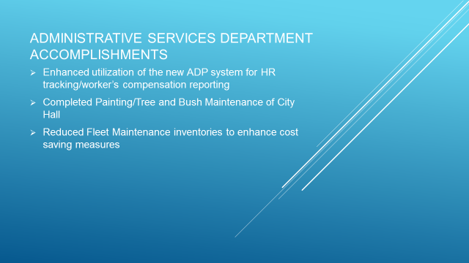

Slide 27
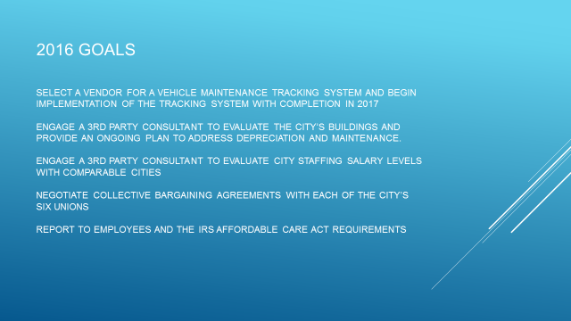

Slide 28
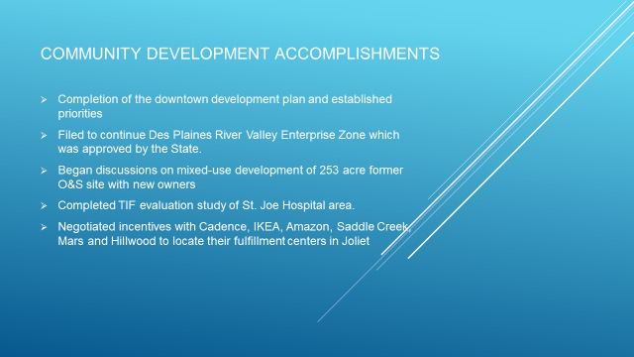

Slide 29
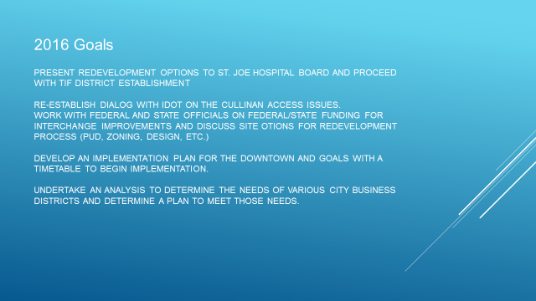

Slide 30
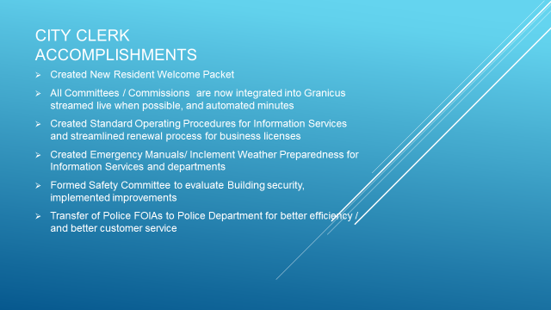

Slide 31
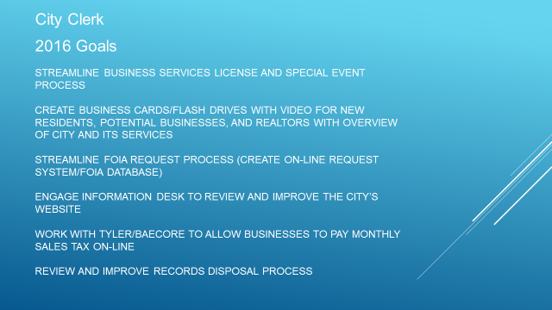

Slide 32
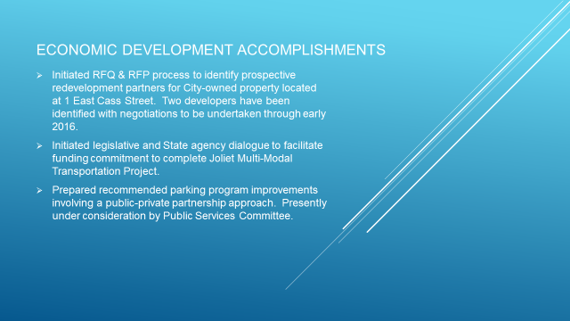

Slide 33
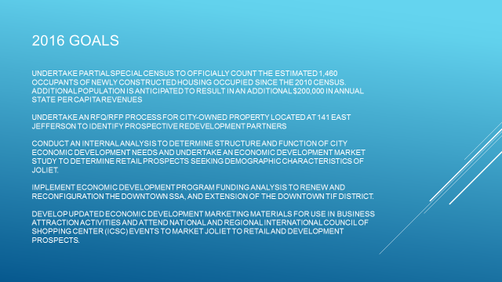

Slide 34
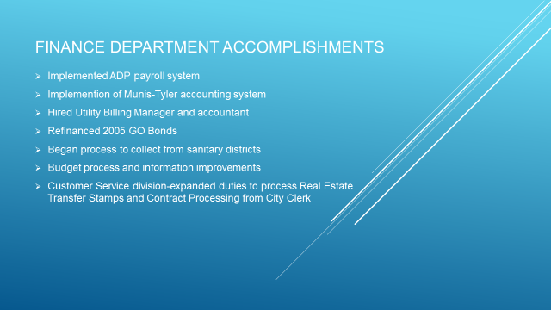

Slide 35
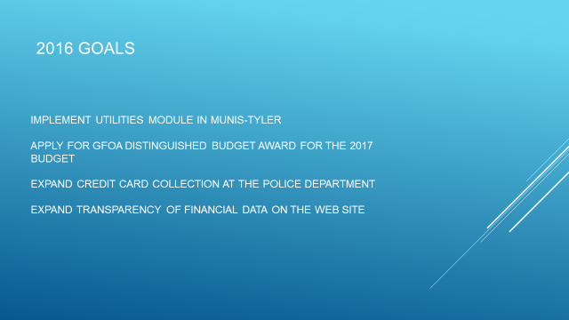

Slide 36
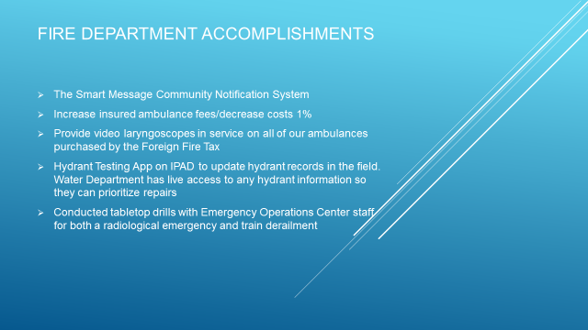

Slide 37


Slide 38
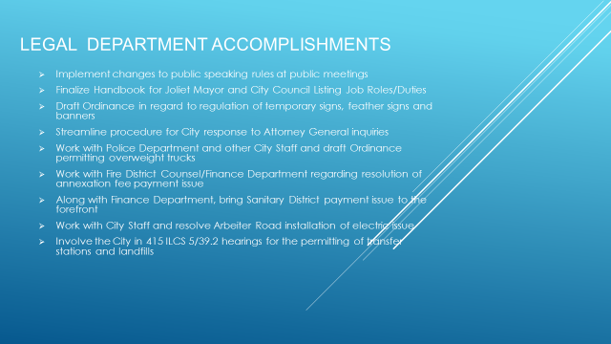

Slide 39
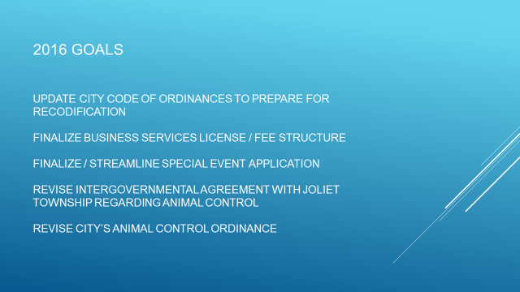

Slide 40
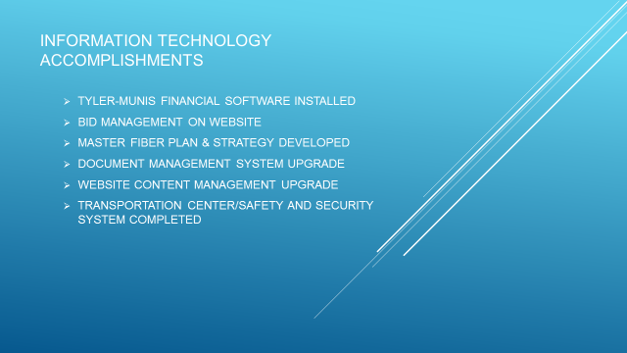

Slide 41
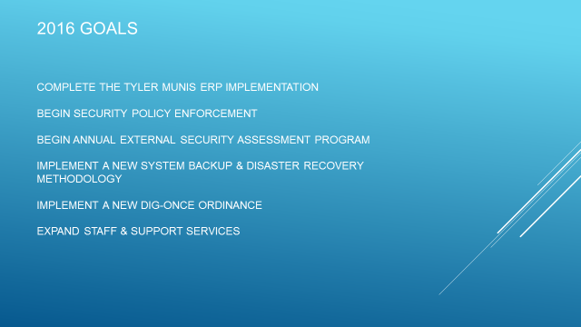

Slide 42
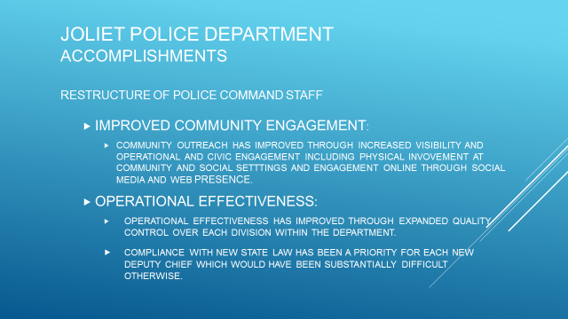

Slide 43
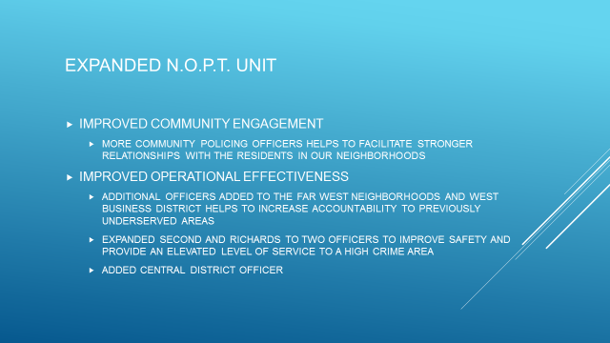

Slide 44
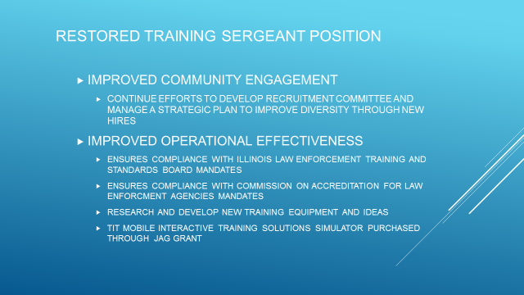

Slide 45
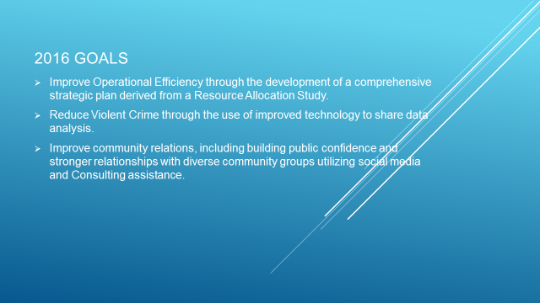

Slide 46
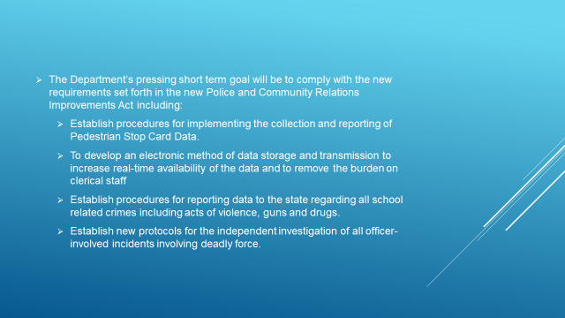

Slide 47
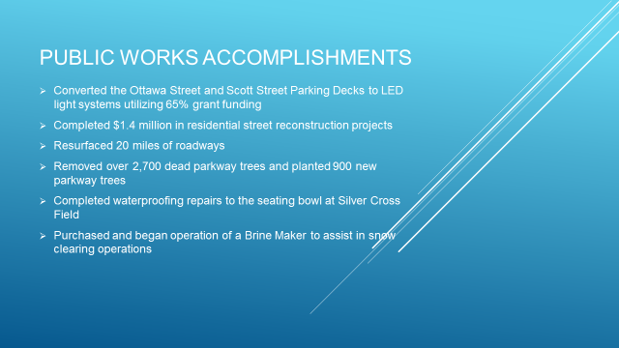

Slide 48
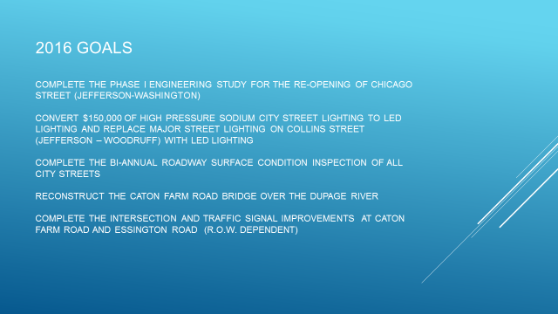

Slide 49
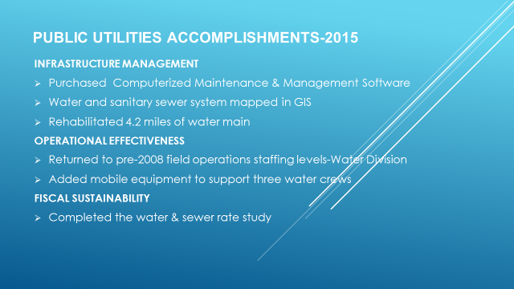

Slide 50
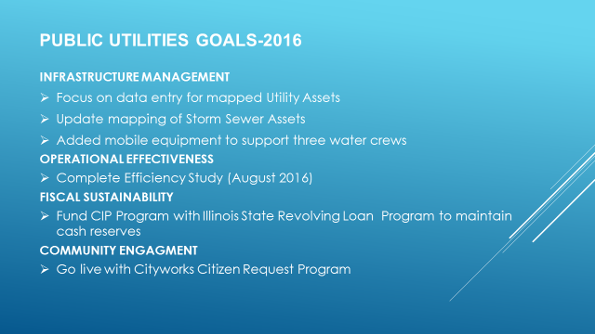

Slide 51
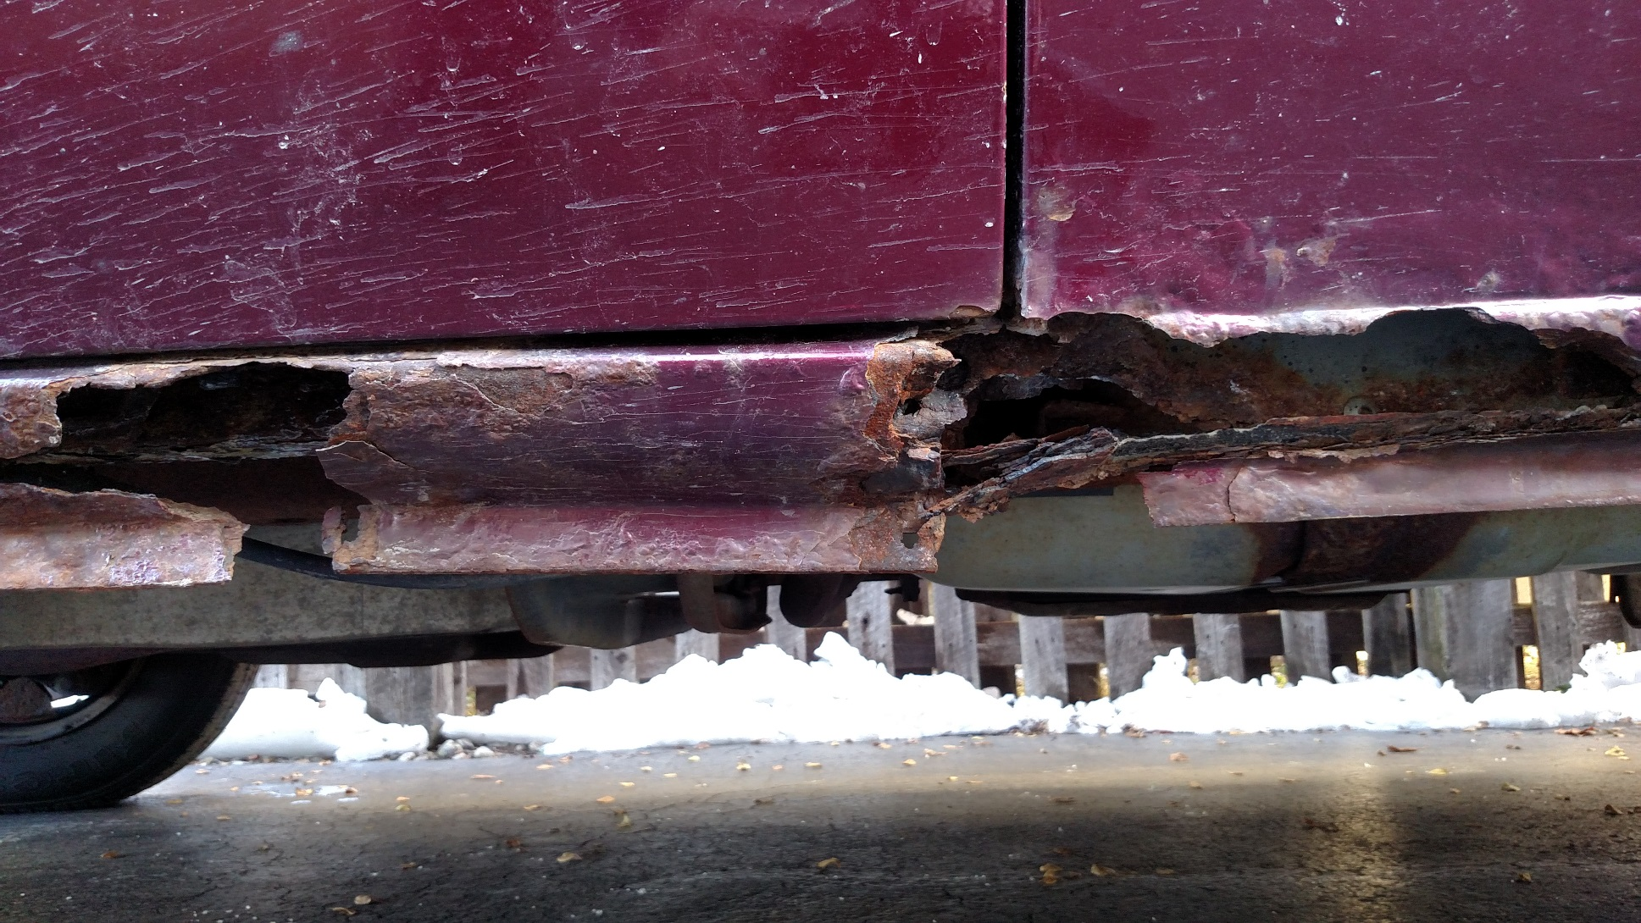
FD Service Vehicle

Slide 52
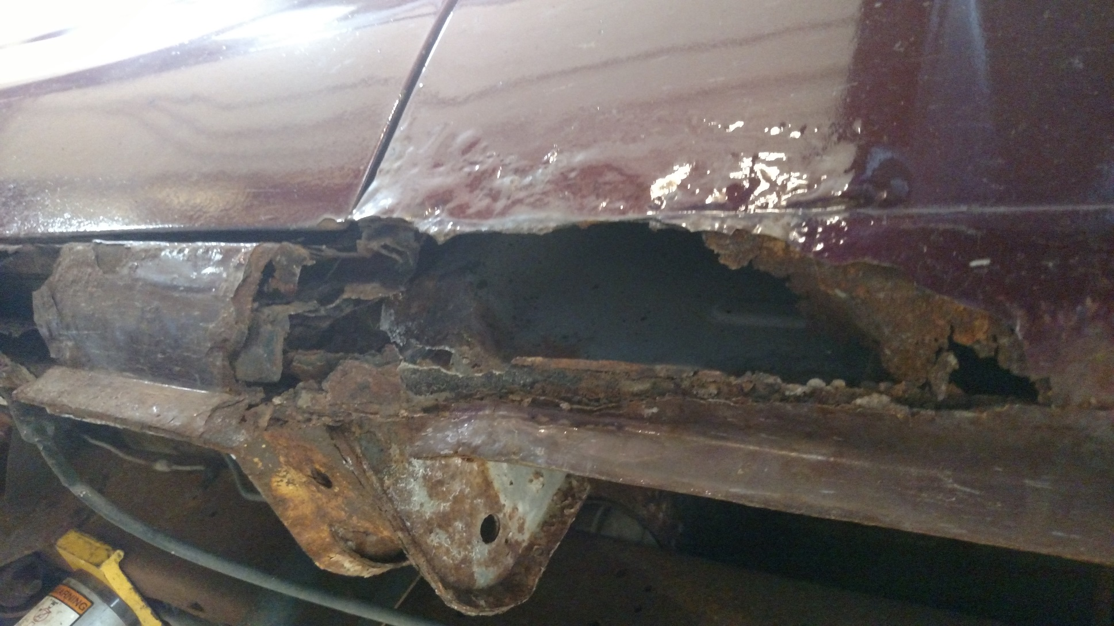

Slide 53
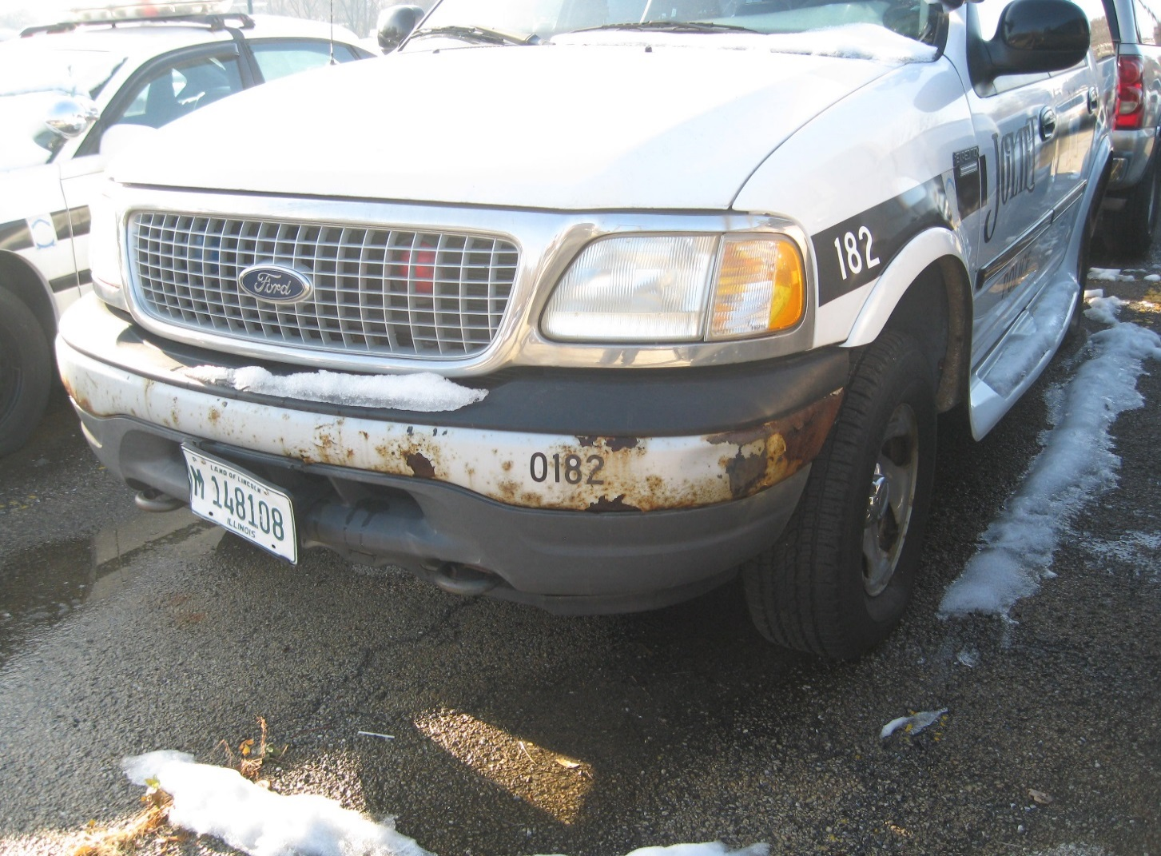

Slide 54
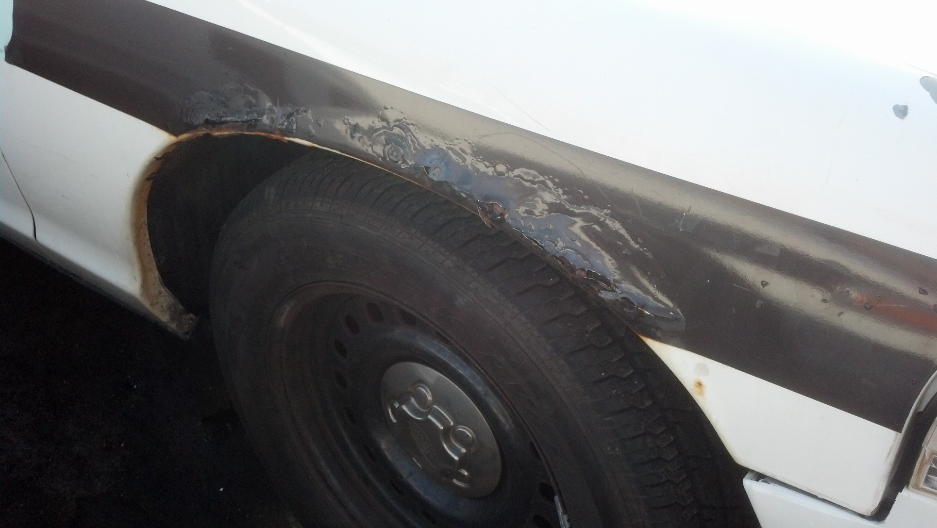

Slide 55
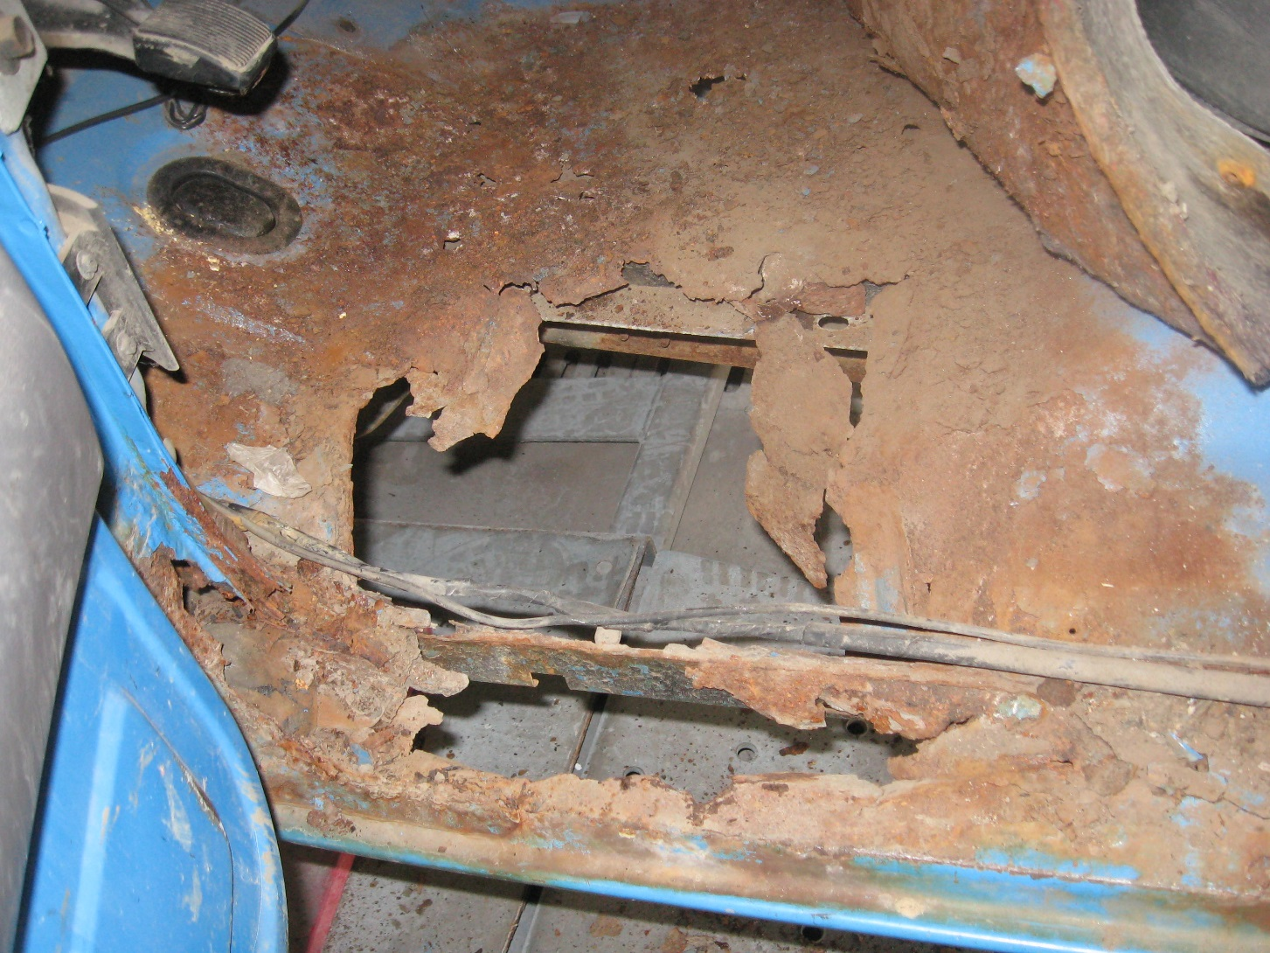

Slide 56
Thank you
2016 Proposed Budget

