Slide 1
City of Joliet
2020 Water Main Improvements
Pre-bid Conference
November 13, 2019

Slide 2
Overview
Bidding Requirements
City of Joliet
IEPA Loan
Important Dates
Water Main Improvement Projects
Mills Road
Raynor Park Phase 2A
Raynor Park Phase 2B
Ridgewood Phase 2

Slide 3
Bidding Requirements
City of Joliet
Prequalification (Ordinance No. 7345)
City of Joliet Procurement Code
Local Bidder Ordinance does not apply
City’s 10% minority participation
City of Joliet Affidavits
Download documents from City website and sign up for RSS feed
Check City website for any addenda
IEPA Loan
Advertise for DBEs in daily regional paper
One advertisement is acceptable for multiple projects, must meet earliest date
Provide list of all subcontractors
Can use DBE Form #4
Davis-Bacon or Illinois Prevailing Wage Act, whichever is higher
Use of American Iron and Steel

Slide 4
Bidding Requirements
Specifications and Measurement of Payment
Contractor must meter and pay for water
Zinc-coated ductile iron water main and anti-microbial polywrap
Trench backfill tables in M&P
Preventing job abandonment
Water services within 7 days of IEPA approval
Final pavement restoration within 21 days of last water service or moving to another street
Option for temporary pavement within 7 days at no cost to the City
Bid Submittal Checklist for IEPA requirements
Liquidated Damages: $1,200 / $600
Max trench width: 6’ unless directed by City to relocate trench
Pavement Restoration Thicknesses

Slide 5
Bidding Requirements
Important Dates
Last day for DBE Advertisements:
Raynor Park Phase 2A November 24
Raynor Park Phase 2B November 24
Ridgewood Phase 2 November 25
Mills Road November 25
Last day for questions: Wednesday, December 4th
Bid Openings at 150 W Jefferson:
Raynor Park Ph 2A December 10, 10:00 AM
Raynor Park Ph 2B December 10, 2:00 PM
Ridgewood Ph 2 December 11, 10:00 AM
Mills Rd December 11, 2:00 PM
Estimated Notice to Proceed, contingent on IEPA Loan: May 1

Slide 6
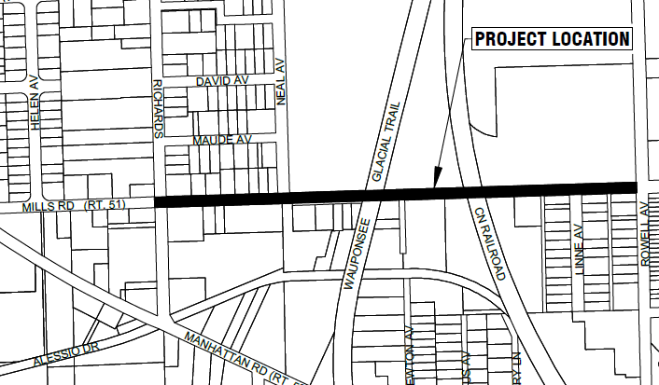
Water Main Improvement Projects
Mills Road
2,400’ of 12” CIP liner
300’ of 12” ductile iron water main
210 SY of full depth patching
Includes coordination with IDOT, WCDOT, and CN Railroad
Substantial Completion: 120 calendar days
Final Completion: 150 calendar days

Slide 7
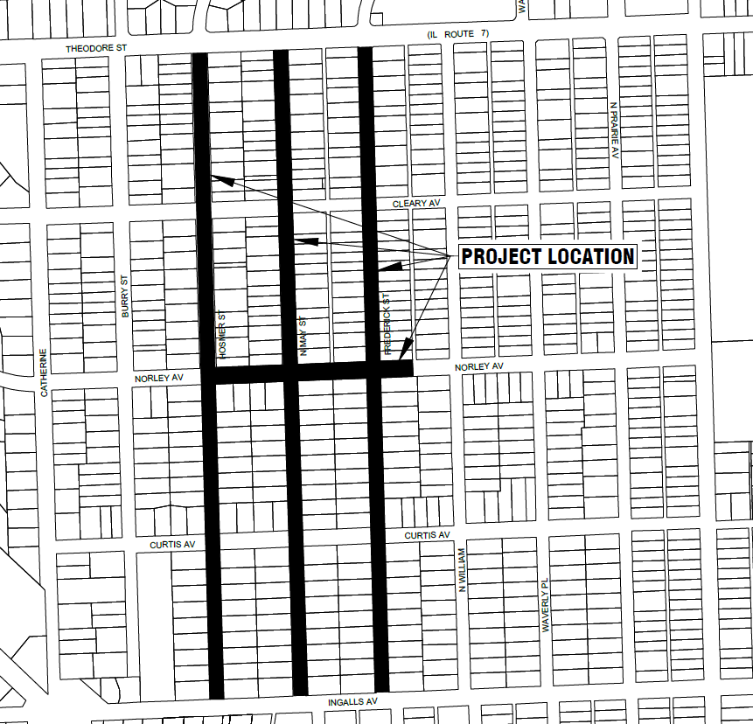
Water Main Improvement Projects
Raynor Park Phase 2A
9,100’ of ductile iron water main
City will complete pH testing and sign LPC-662
Includes work in IDOT ROW
7,150 SY of full depth patching
Substantial Completion: 210 calendar days
Final Completion: 240 calendar days

Slide 8
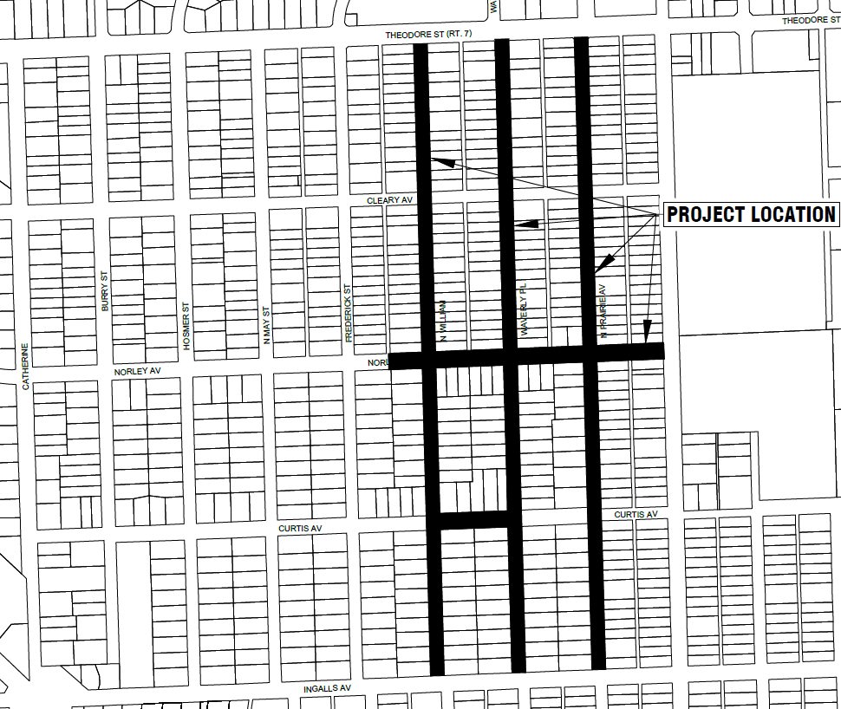
Water Main Improvement Projects
Raynor Park Phase 2B
9,550’ of ductile iron water main
City will complete pH testing and sign LPC-662
Includes work in IDOT ROW
7,100 SY of full depth patching
Substantial Completion: 210 calendar days
Final Completion: 240 calendar days

Slide 9
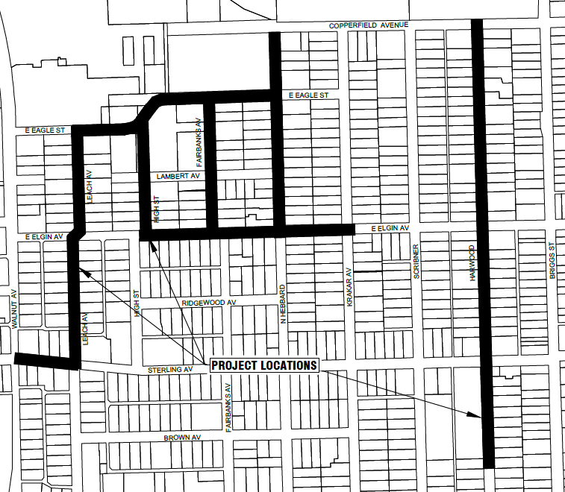
Water Main Improvement Projects
Ridgewood Phase 2
7,700’ of ductile iron water main
180’ of water main removal
5,950 SY of full depth patching
Substantial Completion: 180 calendar days
Final Completion: 210 calendar days

Slide 10
Questions?
Lauren Schuld
lschuld@baxterwoodman.com

